Slide 1

Data journalism for editors
MaryJo Webster CAR Editor maryjo.webster@startribune.com @MaryJoWebster
Notes:
We’re going to try to de-mystify data journalism – otherwise known as computer-assisted reporting or CAR --- and give you a “road map” for working with reporters on data-driven stories. I’m going to try to keep my talking to less than 45 minutes, but I’ll stay and answer questions beyond that. Feel free to interrupt me along the way if you have a question that can’t wait until the end.

Slide 2
What is data journalism?
A story that relies heavily on our own analysis of data, and would either be impossible or very difficult without it
A story that uses our own data analysis to provide context or more support to a story
A data-driven digital product: i.e. interactive map, graphic, database, news app, data visualization
Notes:
What is data journalism? Otherwise known as “computer-assisted reporting”
The primary definition of data journalism is when we are doing our own analysis of data – not relying on something produced by someone else. This analysis might be the focal point of a story or might be the only reason a story is possible. Or it might just provide some context or support for a story.
A secondary definition – that has developed over the last half dozen years or so – includes the various digital products we can develop from data, such as interactive maps or graphics. These are sometimes called visualizations or news apps.
What is NOT data journalism?
Looking up a single number or a few pieces of information from an online database. Or asking a source for summary data -- such as the total number of complaints against a police officer or the number of times OSHA inspected a local business.
Let’s look at a few examples....big and small

Slide 3
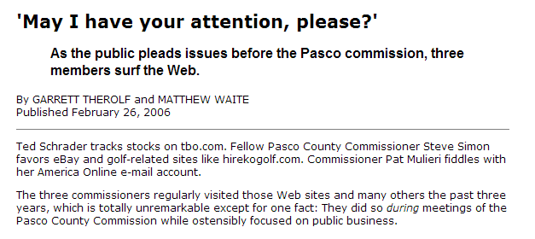

Data: Internet history for all county employees
Notes:
This is one of my favorite examples. Reporters at the St. Petersburg Times were wondering what the Pasco County Commissioners were doing during commission meetings. All of them had their heads down, consumed by their laptops. By asking a few questions, the reporters found out that those computers were connected to the county’s network. And the county kept Internet history logs, specific to each user. And yes, those were public records. So the reporters requested the history logs, filtered it down to the commissioners’ user IDs, then filtered it down to the days and times when meetings occurred. Then they looked at which sites the commissioners were visiting and wrote this great – yet rather simple – story telling the readers which sites those commissioners were visiting. And readers could quickly ascertain that it sure didn’t seem like official govt business.

Slide 4
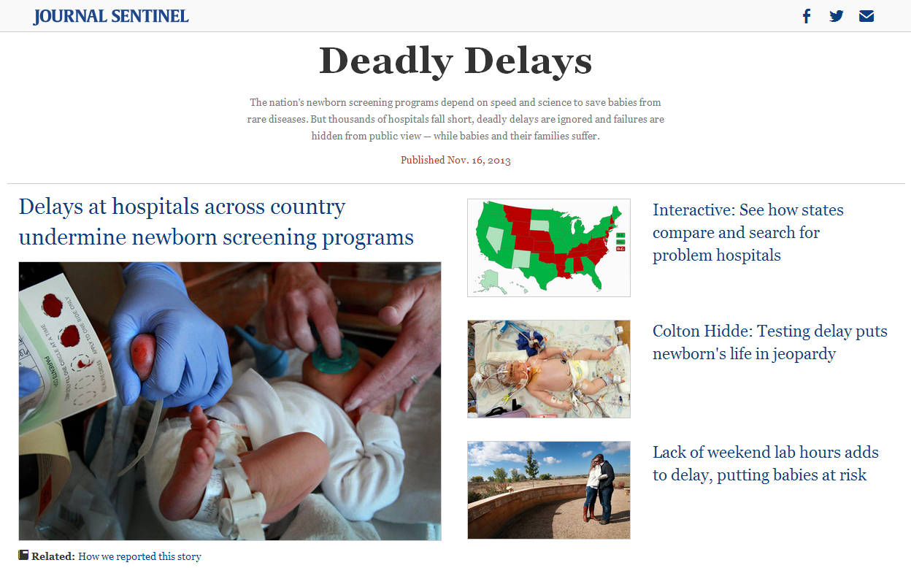
Data: Asked every state for data on all newborn screenings done in 2012 * 31 states provided data
Notes:
By doing our own data analysis, we aren’t confined by the questions that public officials posed and published in their annual reports or press releases. We can ask questions of the data that haven’t been asked.
This is a very large scale example of that kind of thing, but the idea is a simple one….how often are newborn blood screening samples done within the recommended amount of time to help doctors catch potentially life-threatening conditions in newborn babies?
Since nobody else had asked this question – or even collected all the data – the Milwaukee Journal-Sentinel set out to do it themselves. The resulting story showed that a lot of officials were surprised by the answer; they simply didn’t know the answer because nobody had ever asked the question. This resulted in an amazing story that started having an impact even before it published.
This project was very large and not something every paper can do….but think about this concept of asking a question that has never been asked. You can do that with a lot of things – some being quite simple, others being more demanding like this one.

Slide 5
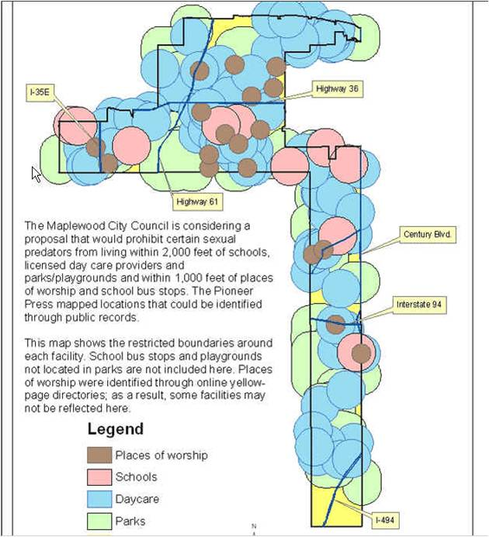

Data: collected either addresses or GIS maps with locations of schools, parks, daycares and places of worship
Notes:
Several years ago, a suburb of St. Paul was considering an ordinance that would’ve prohibited where certain sex offenders could live. The proposal called for banning them from living within 2,000 feet of daycares, schools, parks and playgrounds. And within 1,000 feet of places of worship and bus stops. We used various datasets to find the locations of these places in that city (we didn’t do bus stops or playgrounds) and then used GIS tools to analyze what portion of the city was left after the restrictions were applied. This map was the result – showing only two small sections of the city unaffected: one was an industrial park in the northern part of the city and the other was under a major interstate highway in the lower part of the city. The following week, the city council tabled the plan and hasn’t brought it back since.

Slide 6

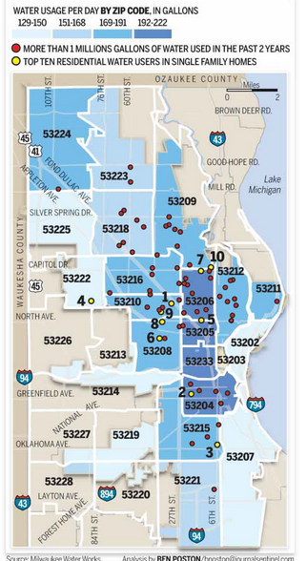
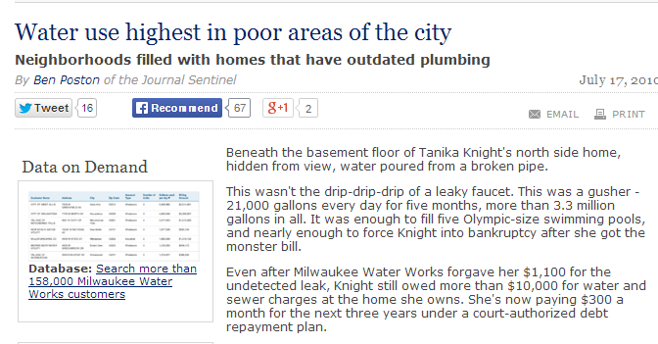
Data: City data on water usage at each address (water billing records)
Notes:
The Milwaukee Journal-Sentinel also asked another interesting question: are there certain parts of the city that use more water than others? (Another way to think of this….are the affluent neighborhoods using a disproportionate share of water because they water their lawns all the time?)
The answer surprised a lot of people: the greatest usage was in the poor areas of the city. Shoe-leather reporting helped them answer why: houses in poor neighborhoods were less likely to have modern toilets, showerheads, etc. that use less water and they were more likely to allow water leaks to go unresolved for longer periods of time.

Slide 7
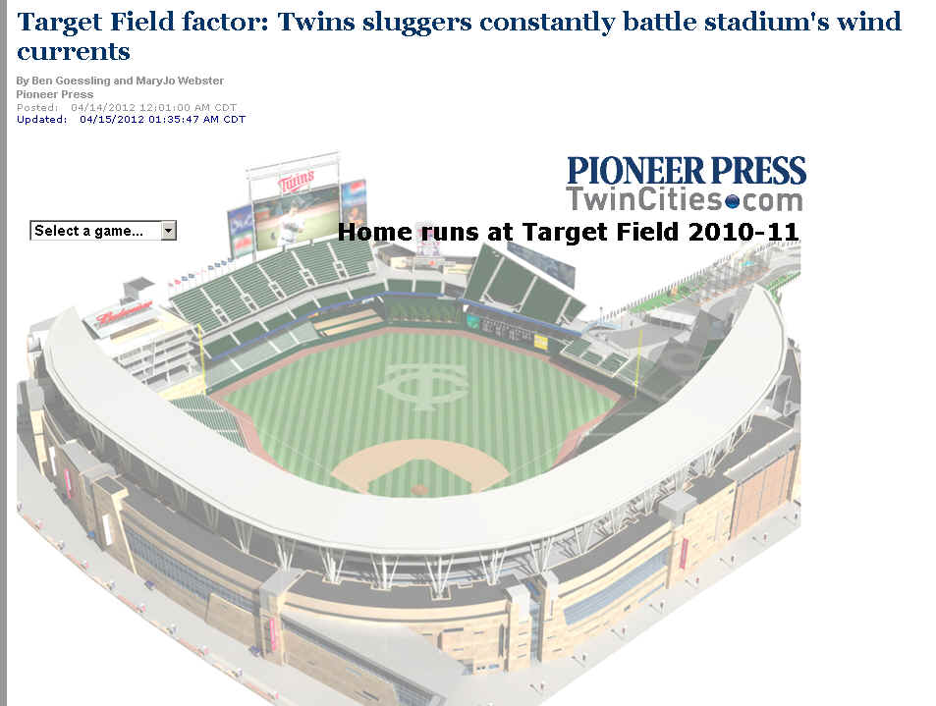
Data:
Hitting data by team for each game
Weather data by day and start time of game
Notes:
Journalists spend a lot of time writing about whether something is true or not. Most of the time we end up with a lot of “he said she said” -- various people or experts batting around the various opinions or theories.
But sometimes journalists could measure whether something is true or not, using data.
At the Pioneer Press we were getting ready for the third season that the Minnesota Twins baseball team would play in their new stadium, Target Field. The big question everybody was talking about was why the Twins had such a horrible record hitting homeruns those first two seasons. There were tons of theories floating around. But the players all talked about one – the weather.
The baseball reporter gathered game-by-game hitting data for the Twins and their opponents; I gathered daily weather logs from the closest weather station; and we recruited a meteorologist to advise us. Putting the two datasets together enabled us to see trends in hitting – particularly homeruns – under different weather conditions.
This kind of marriage of two datasets not intended to go together is one of the best ways to get truly unique stories

Slide 8
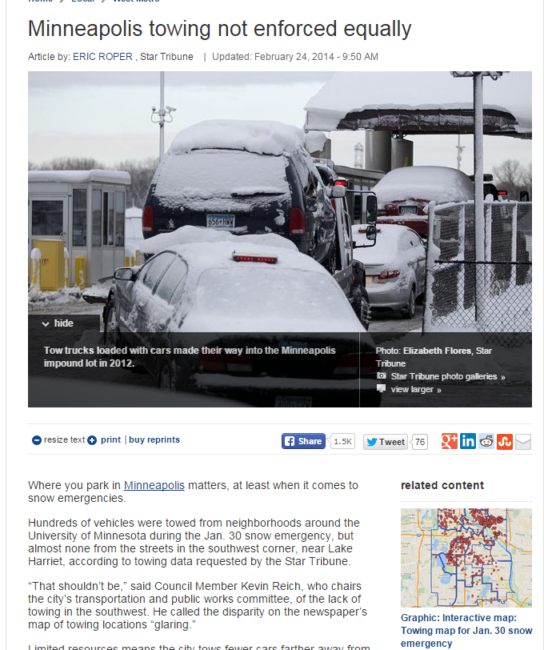
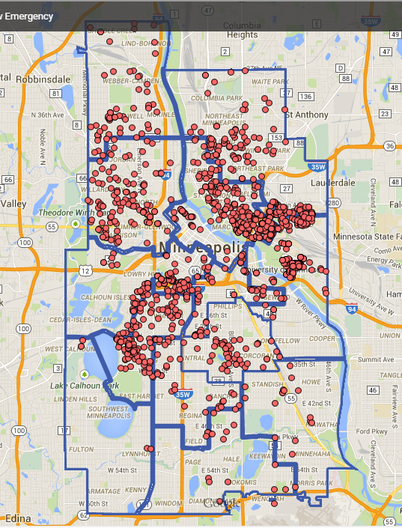
Notes:
Here’s an example of how data analysis can lead to good stories for beat reporters. This is a story by Eric Roper that developed as a result of his analysis of cars towed during snow emergencies. Mapping the data enabled him to see that no cars were towed from the southwest corner of the city.
When Mila Koumpilova was at the Pioneer Press, she did a really good job of finding ways to incorporate data into her beat on a regular basis. We requested the school district’s “checkbook” register and she frequently mined that for small bits to add to stories and then a couple larger stories about district spending. When she wrote about proposed changed in the way schools are funded (out of the district coffers), she got the funding data. When she wrote about the district’s latest effort to close the achievement gap, she pulled test score data on the various sub-groups and looked at how that had changed over time.
She found that getting the most detailed data she could – rather than just a couple of summary numbers – gave her more fodder to work with. She found more questions, which led to more answers and more interesting stories.

Slide 9
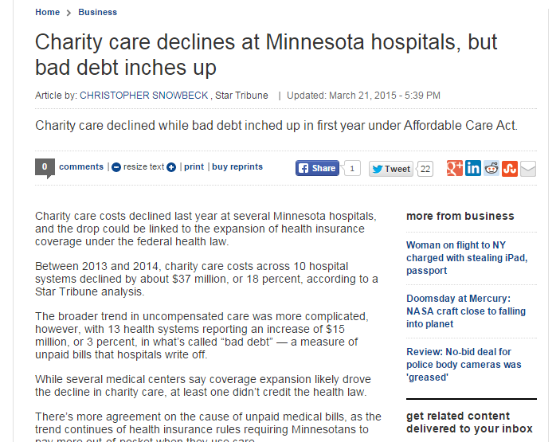
Snowbeck has his own database where he stores various information on MN hospitals, including charity care, profitability, ER usage, surgeries and other details.
Notes:
Another way beat reporters can put data to use on their beats is to build their own databases – it guarantees you’ll have unique stories.
Chris Snowbeck keeps his own database with various info on Minnesota’s hospitals, including charity care, profitability, ER usage, surgeries and other details.
He tapped his database for this story on how charity care has declined.

Slide 10
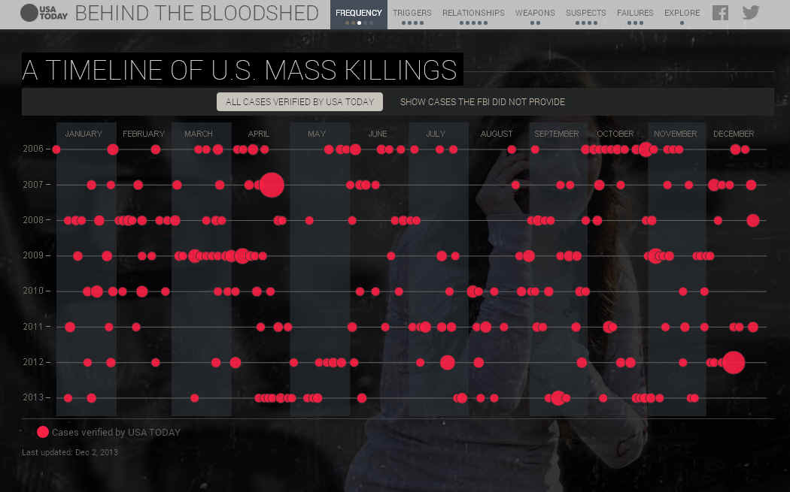

Put big events into context
Data:
FBI data
Media reports
Local police records
Notes:
Data is really good at putting events into context and you have probably seen lots and lots of examples of this. This one is from USA Today – they built a database of all “mass killings” and then generated stories and interactives from it to help show that mass killings occur far more often than we realize and that the big events that show up in the news– like Sandy Hook – are pretty rare.

Slide 11
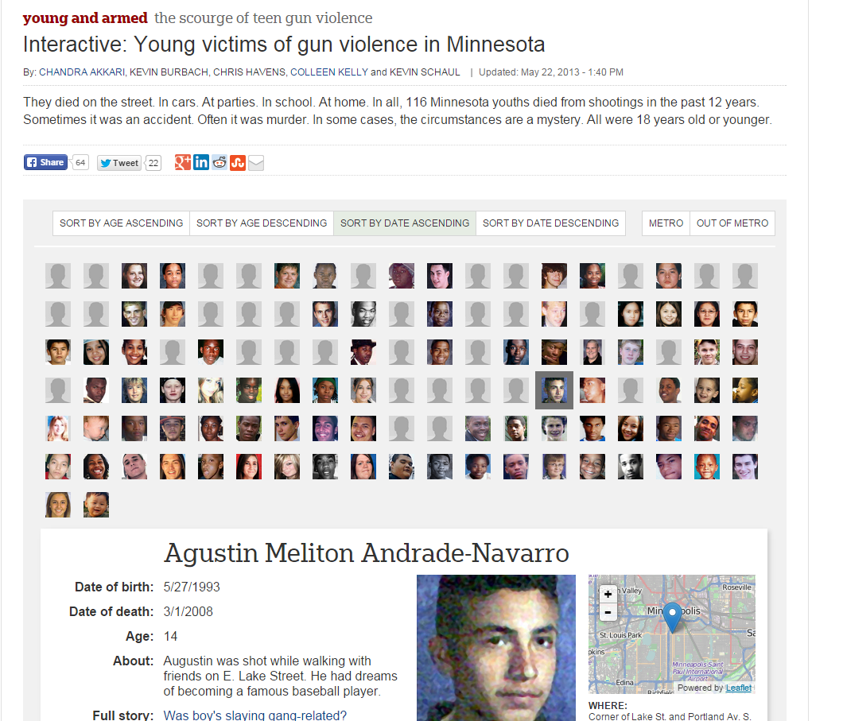
Interactives: Let readers find their own stories
Notes:
As we’ve just discussed, getting detailed data can be really helpful for the reporting and result in much better stories – but it also gives us a better opportunity to engage readers. We can put that data online and let readers find their own stories.
Here’s an example from the Young and Armed project that allows readers to explore details about each of the young people killed by gun violence in Minnesota.
For example, a lot of news organizations have created interactive crime maps/graphics like this one from the Chicago Tribune. It gets updated regularly and readers can see broad trends, then zoom in on their specific neighborhoods and see specific incidents.

Slide 12
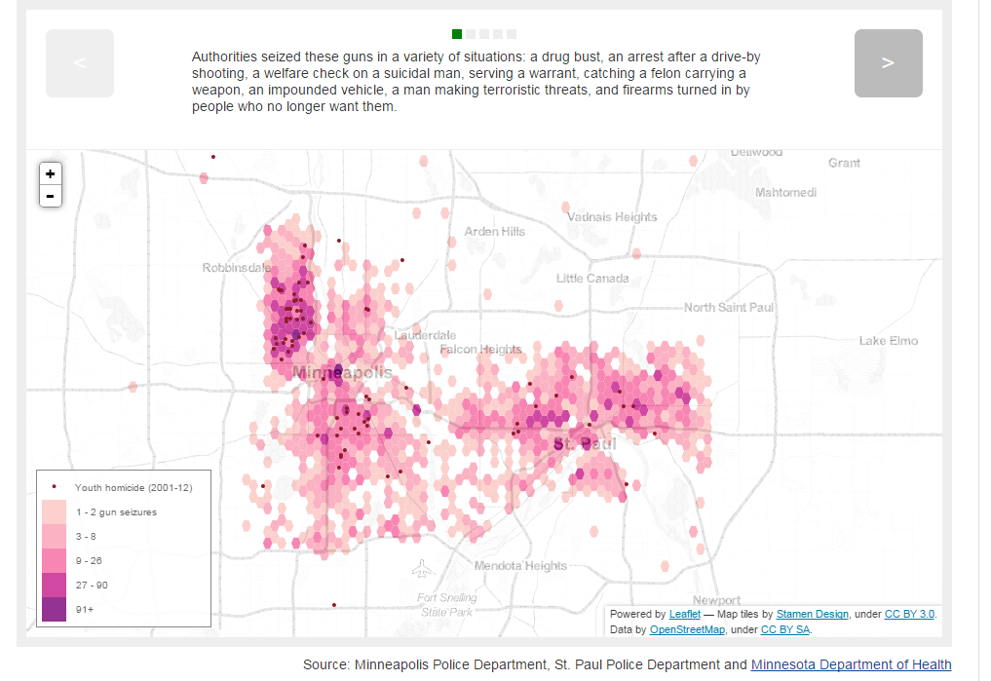
Notes:
As part of that same Young and Unarmed project, we also had this interactive that overlays youth homicides with concentrations of gun seizures-- It walks readers through some key points, but then they can find more information about each of the homicides by clicking on the dots. It’s quite apparent that the majority of these homicides occur in areas where there is a lot of guns seized by police – although those two factors are very intertwined so it’s sort of a chicken and egg situation.

Slide 13
What is “data”?
Notes:
Before we get too much farther, I’d like to take some time to just talk about what I mean when I use the word “data.”

Slide 14
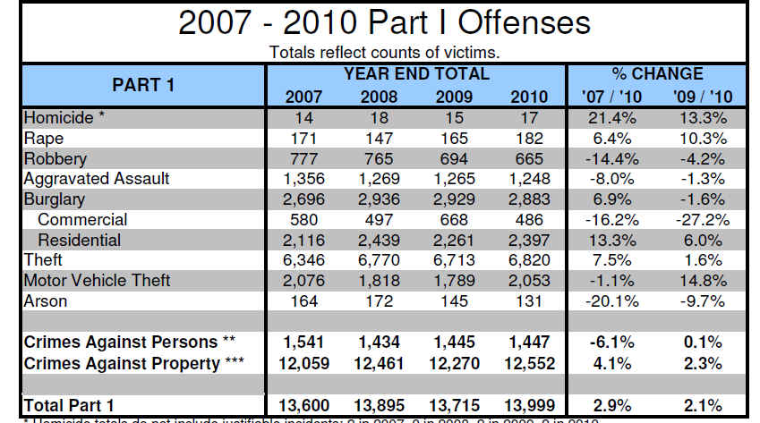
Aggregate
or
Summary
Notes:
We’re all very accustomed to data like this – a summary or aggregate. Officially, though, this is “information” that was generated from data.
Still there are times when we can only get aggregate or summary information– data from schools is one of the best examples. We can’t get records showing how each student did on their standardized tests, but we can get an aggregate for groups of students (all black students in one grade in one school, for example).

Slide 15
Questions we can ask the aggregate data?
Which crime(s) had biggest increase or decrease across the three years
Compare property crime to crimes against persons
Notes:
The questions that you can ask aggregate data will be restricted by the amount of information you’re provided.
This police data is very limited. In fact, the answers to our questions are already there – we don’t need to do any of our own analysis (although we might want to check their math)

Slide 16
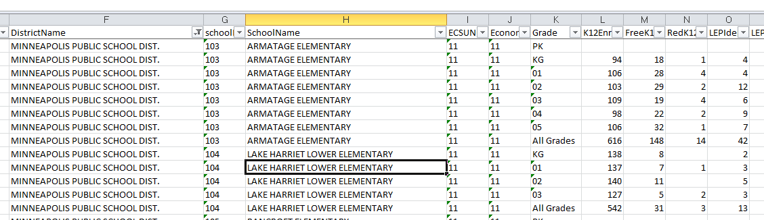
Notes:
But aggregate data that is more complex – such as this one – offers more opportunity for questions.
This is enrollment data – by “special populations” – for all schools in the state. I’ve zoomed in on some Minneapolis schools. You’ll see that there is one record for each grade, plus a record that combines all grades. Then it shows the number of students on free lunch, reduced price lunch, limited English proficiency, special education, etc. We could use this data to find which schools have the highest concentration of poor students. Or we can get multiple years of this same data and see which schools have had the greatest increase or decrease.
Or we could do this same analysis but at the district level, rather than school level.

Slide 17
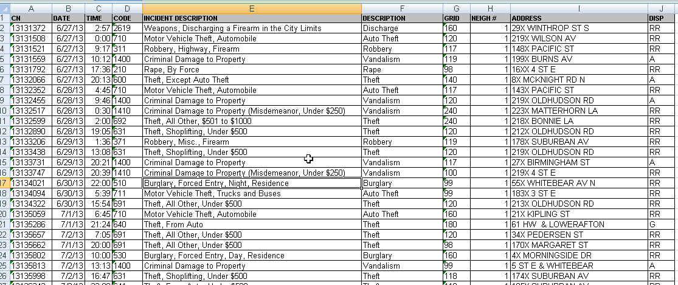
Raw data
Notes:
But in situations where we are not restricted by privacy laws, we should always try to get as detailed data as we can – this is what is called “raw data.”
Raw data is what is used to generate those summary charts, like the police UCR report one we just looked at.
This is from the St. Paul police and shows one record for each incident. It shows where it occurred by an address, the neighborhood and the police district; It has the date and time it was reported, the type of incident and whether it resulted in a report.

Slide 18
Questions for the raw data?
Which neighborhood had biggest increase in crime?
Were some parts of the city more prone to certain types of crimes than other neighborhoods?
Is there a time of day or day of week when more crimes are reported?
Per capita crime rates
You can turn this into a map!
Find crime reports at particular addresses
Notes:
So now we have lots of questions we can ask. Not only can we generate the same kind of summary report, but we can go off in other directions.
We could match this data up to another dataset that has addresses for all the schools in the city and see how often reports are taken there.
We can compare neighborhoods -- is gun violence increasing faster in one neighborhood than another?
We can look at more detail – instead of just knowing that there were 6800-ish thefts in 2010, we can see what kinds of thefts (items from cars? shoplifting? etc) and where it’s occurring most.

Slide 19
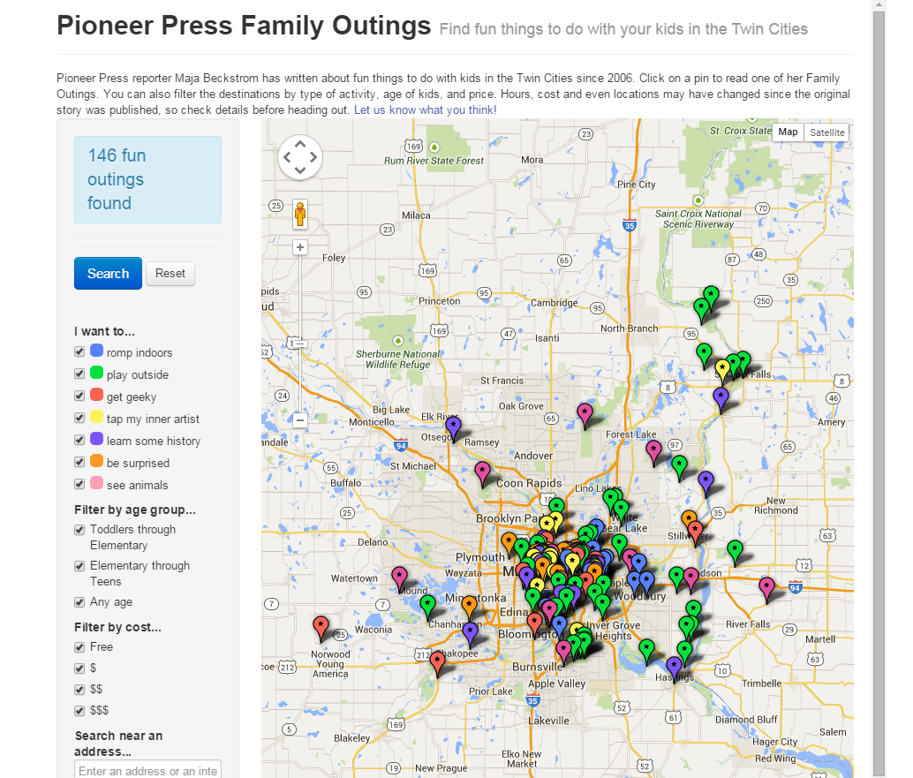
Anything can become data.....
Notes:
You can turn just about anything into data. At the Pioneer Press, we built a database of stories that the Family reporter had written and then turned it into an interactive map that parents could use to find cool things to do with their kids.

Slide 20
NY Times reporter Derek Willis – database of congressional press releases
search for “Ebola” in title
January-June, 2014 | 0
July | 2
August | 8
September | 56
October | 275
Notes:
“Data” doesn’t have to start out in rows and columns. NY Times reporter Derek Willis keeps a database of every congressional press release (he scrapes them from the Web) and then he can tap it for various things now and then. Last year as the Ebola crisis was hot news, he wondered what the press releases had to say about Ebola....and his data showed that the discussion among the Congressmen had heated up at pretty much the same pace as the news coverage.

Slide 21

Data is a source
Notes:
The #1 thing to take away from this session is that you – and your reporters – should be treating data the same way you treat human sources.

Slide 22
Same sourcing rules apply...
Is this source reliable? And how do you know that?
What can and can’t this source tell us?
Verify what this source tells you
Make sure you use more than one source
Notes:
The best thing you can do to backstop your reporter on a story involving data analysis is to ask the same questions you would when they have a new source
especially – is this source reliable? and how do you know that?

Slide 23

If you ask wrong question, you’ll get wrong answer
Notes:
When talking to humans, you might get a wrong answer if you phrase your question in a way that they don’t quite understand. Data works the same way – the difference is that you are asking your question in “computer speak”, so it’s much easier for us to trip up – since that’s not our native tongue. To get around this, it’s a really good idea to ask lots and lots of questions – framed in different ways. Luckily, data will sit and answer questions for hours and hours on end, without getting annoyed by you.

Slide 24
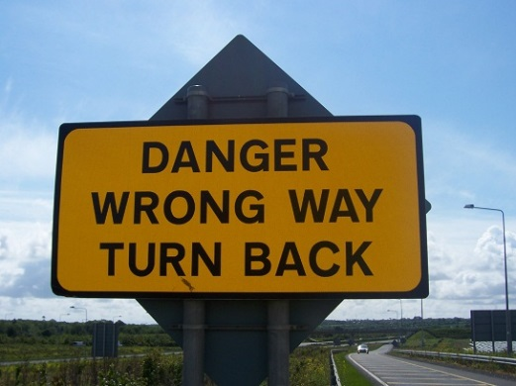
If something doesn’t seem quite right, check it out
Notes:
As with human sources ,we sometimes get led to believe something might be true, but our gut says maybe it’s not.
There are all kinds of ways your analysis results can end up with big outliers or unusual results – and the majority of the time it’s either the result of faulty data to begin with or some error in the analysis. But we can prevent publishing something incorrect or out of context by following the same rules we use with human sources --- checking our results against other sources and looking for ways to disprove the results.

Slide 25

Data can only tell you what it knows
Notes:
Like people, we have to approach data analysis with the understanding that the only answers we’re going to get are ones that the data has the “knowledge” to answer. If something is not in the data you request, you might not be able to get the answer you want.
Several years ago, a reporter at the PiPress asked for data on foster care homes that had had their licenses suspended or revoked. She asked that the data include the reason the license was pulled. DHS kind of freaked out on us. We got their data people to have a phone conference with us and then they explained that their database doesn’t include the reason – that information only existed in their paper records. The database was essentially an index of their paper records.

Slide 26

It will often lead you to more questions…
Notes:
The analysis and reporting phase of the story should be one – with the reporter going back and forth between data and human sources. Oftentimes, the humans will lead the reporter to something in the data that they hadn’t thought to look for before.

Slide 27

But shoe-leather reporting
is as important as ever…
Data should not be your only source
Notes:
There are people who will know the topic or the particular dataset better than we do and it’s crucial that we get their feedback on our analysis. If they question our analysis, even slightly, it’s important to go back and review our work, if not re-do it altogether. A key part of your job is to make sure the reporter has consulted one or more people and shown them the results.

Slide 28
Managing/Editing data journalism
A road map
Notes:
Let’s turn our attention to some more specific things you can do to foster data-driven journalism in the newsroom and support your reporters when they are doing data-driven stories.

Slide 29
Beat development
Encourage reporters to find their data “sources”, add them to their Rolodex, take them “out for coffee,” etc.
Give reporters time to explore a dataset that is crucial to his/her beat, perhaps even generate a minimum story from it
Notes:
Since we’re thinking about data in the same way we think about human sources, it’s a really good idea for reporters to develop these sources on their beat in much the same way.
Reporters should spend time finding the various data sources that exist on their beat, request a copy of the data and “take the data out for coffee” so-to-speak, to get to know what’s in there and what they might be able to use it for down the road.
It might also be possible to find a basic – or what I call a “minimum” – story based on the data, helping readers understand something. For example, education reporters might spend some time perusing the enrollment data we looked at a few minutes ago and then do a quick story on which schools or districts have seen the greatest increase in the percentage of students on free or reduced price lunch.
Once you have at least a basic understanding of a database , then the reporter will be in a much, much better position to use that data for a story later --- especially if it’s a situation where you have to turn it around quickly. Oftentimes the most time-consuming part of a data analysis is understanding the data in the first place.

Slide 30
Ideas
Encourage reporters to frame ideas as questions, not nouns.
How can we prove the key point?
How can we measure/quantify that?
How can we find all the examples of that?
Data by beat
Notes:
When reporters talk with you about story ideas bubbling up on their beat, this is a really great point in time for you to help them identify data opportunities.
The first thing you can do is encourage reporters to frame their story ideas as questions, not nouns. For example, instead of saying I want to do a story about “bad bridges,” it would be better to say “I want to find out how many bad bridges there are in Minnesota.” This frames your topic into something measurable – then it’s just a matter of finding the right data that will allow you to measure that. And yes, it’s okay to have more than one question.
With every story, you are probably already asking “How can we prove the key point?”. Instead of just thinking about WHO can help us prove that key point, also ask the reporter whether there’s data that can help.
A similar question is “how can we measure or quantify that?” So for example, remember the Milwaukee Journal Sentinel story about water usage. They probably started with the question along the lines of – do the rich neighborhoods of town use the most water? Then they found data that would allow them to quantify water usage for each property, and then through their analysis, they could summarize that water usage up to the neighborhood level and marry that with census data on income.
Asking for data can also be a way to find anecdotes. Let’s say you want to do a story about heroin deaths – you could start with the state’s death database and find all the people who died from heroin and then track down family members.

Slide 31
Should we use data analysis?
Has somebody already done this analysis?
How complicated is the analysis?
How important is this story?
How much time do you have?
Notes:
Of course, not every story is going to suitable for data analysis. Here are some questions to ask when deciding whether it’s worth it....
Has somebody already done this?
Maybe the work is already done and it’s not worth reinventing the wheel. On the flip side, you might find similar work by other journalists, academics, non-profits, etc., that might be inspiration for your own work.
How complicated is this? This will give you a sense of how much time it might take. Will the data be hard to get? Is this analysis something the reporter can do themselves or do they need help from me? Do we have the right software?
How important is this story?
This is a key one. If this is an ongoing issue or a crucial piece on your beat, then it’s probably worth the extra time to do some data analysis and go deeper.
How much time do you have? It always comes down to time, right? But also keep in mind that there might be a quick turn story to do and then come back later with a deeper dive.

Slide 32
How long will it take?
Waiting for requested data
Cleaning data, if necessary
Analyzing data
Reporting and repeating analysis
Notes:
This is always the big question I get asked. The short answer is: “it depends.”
There are typically 4 steps to a data analysis and the length of time on each one is dependent on the size and scope of the data, availability of data, etc. So for example, the Target Field story we talked about earlier was one that we turned around fairly quickly – I think we spent maybe a month on it, but almost that entire time we were doing other things, as well. It took awhile to find and build the data we needed, but then there really wasn’t any cleaning needed and I did the analysis in less than 2 days.

Slide 33
Requesting data
Make sure reporter does some “reporting” or sleuthing about the data before making request. What’s in the data? What’s not?
Don’t ask for “lists” or “reports” – use terms like “machine readable” or “database-friendly format such as Excel or delimited text”
Don’t just ask for a few pieces of information. Think about context.
Notes:
When asking for data, try to think broader than just that one thing you think you want. For example, let’s say you want a dataset listing all the turkey farms in Minnesota and where they are located. That would mean that you’d want, at minimum, a turkey farm name and an address. So what can we do with that? We can map the locations and show where they are geographically. But that’s about it.
But what else does the agency collect about the turkey farms? Does it say how many barns? Does it give a “maximum” number of turkeys it could hold? Does it say anything about the size of the barns? Does it say when the farm was built or first registered with the state? Name of the company that owns it?
If we get some of the other things, we’ve got even more questions we can ask and more flexibility about what we can do with it.
The data you want might not exist in the exact FORM that you want. For example, Jeff Meitrodt wanted to find all ag-related deaths in Minnesota. He asked the state if they kept such as list or database. They said no. But then he realized that we have a database of every death in the state, with very detailed fields of information about causes of deaths and occupation of the decedent, even a narrative for some of them. Using the occupation and looking for keywords (like tractor) in the narrative field, he was able to pull together a list of deaths -- it’s possibly a little bit short, but it’s better than nothing.

Slide 34
The data has arrived!
Encourage the reporter to come up with some questions and working theories.
Ask the reporter some questions to get a feel for how well they understand the data. If they can’t answer, encourage them to seek out help from experts or the place the data came from.
Notes:
Once it’s time to start questioning the data, encourage the reporter to have some questions and working theories – just like they would when preparing for an interview with a human source. It’s really hard to just open up a dataset and wander around aimlessly. You need some questions to get you started.
Ask the reporter about the data to get a sense of how well they understand it –If it’s clear that the reporter is stumbling, encourage them to seek out an expert who does know the data.

Slide 35
Questions you should be asking...
What does each record represent?
Is it possible that some things might not be included in this dataset?
What’s the time frame of the data?
Are there any fields you don’t understand?
Does it contain the fields of information you expected?
Does the data need to be “cleaned?”
Notes:
Here are some questions you can throw at them....
For example, let’s say a reporter requested that turkey farm data I talked about a couple minutes ago. Ask them if the dataset includes all turkey farms in the state? (the answer is no) Is it possible that there are farms that aren’t included in here? (the answer is yes– it’s only farms that are big enough to require a permit from the MPCA). Does the data tell us the key thing we want to know about each farm? (i.e. the number of turkeys).

Slide 36
Analysis
Encourage reporter to keep an analysis“trail”
Sit down with the reporter, at least once, and have them show you the data and key parts of the analysis
Get digital and graphics people in the loop ASAP
After analysis, have reporter write 2-3 graph summary to help find main points AND the holes
Expect that more analysis will be needed, after additional reporting
Notes:
A couple things you can do to help boost your understanding of the analysis is to first, ask the reporter to keep a data analysis “trail.” This could be done a variety of ways – ideally it would be a kind of journal that shows each step in the analysis. This might be something like this.... (open link)
You could then sit down with the reporter and ask them to walk you through at least the key parts – and maybe even show you how they got to the key findings. Even if you don’t understand the software they are using, you might find this enlightening. And, over time, you will come to better understand the software and how reporters are using it.
Get digital and graphics people involved ASAP – at least ask if there’s potential for a digital interactive.
When the reporter is done with the analysis, ask them to write a 2-3 graph summary of the main points. It should help identify any lingering holes, questions, etc. and provide a road map for the remaining reporting
Expect that more analysis will be needed. It should be a back and forth process, between your data and your human sources

Slide 37
The findings
Do the findings make sense?
If something seems too good to be true, it probably is.
Do findings line up with what sources are saying? Do any sources question the results?
Don’t be afraid to consult experts, ask them to review your methodology and findings
Have critics/key sources reviewed the findings? (don’t wait until the last minute!)
Have reporter repeat analysis
Notes:
When you start looking at the findings, your key focus should be in making sure the results make sense and that the reporter has confirmed them through other means.
At some point, also insist that the reporter repeat the analysis -- start to finish – to see if they can come up with the same results. this is a really good practice for making sure you didn’t introduce a mistake somewhere along the line.

Slide 38
Other things to consider...
Avoid too many numbers in the text of the story. Characterize!
Give readers context & detail through graphics
Do we have the necessary context? Do we have the “compared to what” answered?
Are we portraying the results honestly and not making too much of it?
Notes:
Think carefully about what numbers end up in the story. The text should really only include the trend . Leave the details for a graphic.
Also make sure the story puts the data into the correct context. And this “context” could be a variety of things, ranging from comparisons over time to comparisons with other geographies or something about the data that might influence the trend we’re writing about – but there’s always something.
For example, if we were writing that story about heroin deaths, we would need to include the fact that the death data we got our numbers from may not be counting all of the heroin deaths because sometimes coroners or medical examiners code the deaths as more generic “drug overdose” or “narcotic overdose”.
Related to this is just a reminder to make sure we’re portraying the results honestly and not making too much of it. I’ve found that sometimes we – as journalists – get a little too excited about the whole aspect of doing our own analysis that we might be tempted to play it up more than it deserves.

Slide 39
Editing
Do the math!
Edit the digital content for usability, clarity, style, spelling/grammar and make sure it complements the story
See bulletproofing guides for more --- mjwebster.github.io/DataJ
Notes:
When you’re editing the story – make sure you check all the math. If there’s a percentage change in the story, track down the underlying numbers and make sure it’s correct.
Make sure you get a chance to edit the digital content too!
There are also several good “bulletproofing” guides out on the web – I’ve linked to some on my data training page here (I’ll also give you this link at the end of the slides)

Slide 40
Minimum skills for reporters
Data state of mind
Comfortable with spreadsheets (Excel, Google Spreadsheets)
Uses numbers appropriately (rates, adjusting for inflation, etc.)
Able to request database-friendly formatted data via public records laws
Able to pull data out of a PDF (Tabula, CometDocs, ABBY)
Able to make some simple graphics for internal use or possibly online (Excel charts, Google Charts, DataWrapper, Google Fusion Tables)
Notes:
What should you expect from your reporters?
This is the minimum that I think we should strive for..... Certainly there are probably very few reporters in the newsroom who are at this level, but I know there are several who are very close.

Slide 41
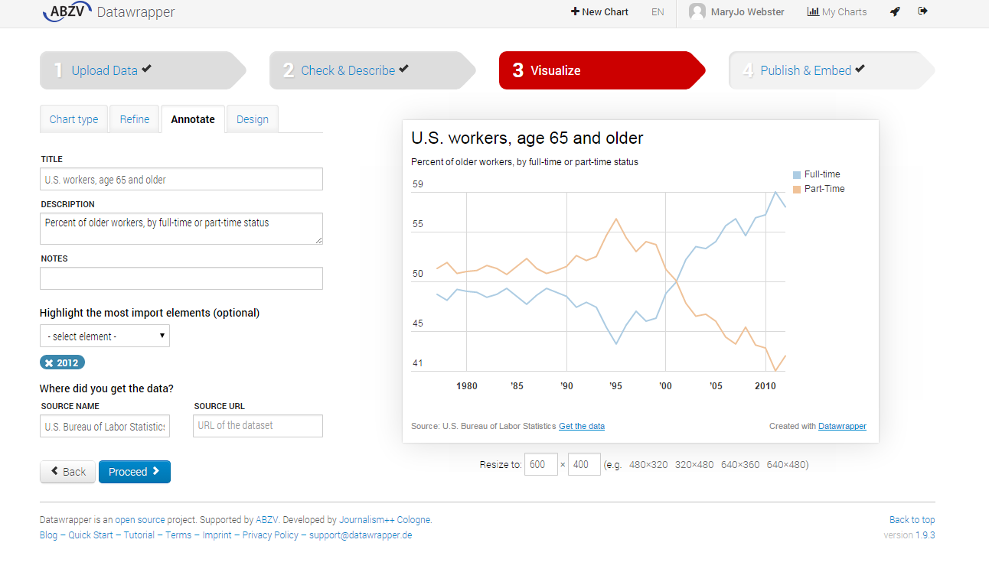
Notes:
Here’s a quick peek at DataWrapper – a tool for making online charts. It’s super simple to use.

Slide 42
Better....
Proficient and very comfortable with spreadsheets
Able to clean data (OpenRefine)
Make data visualizations or simple interactive maps (Tableau, Google Fusion Tables, CartoDB)
Notes:
Beyond the minimum skills...here’s what I’d consider”better”

Slide 43
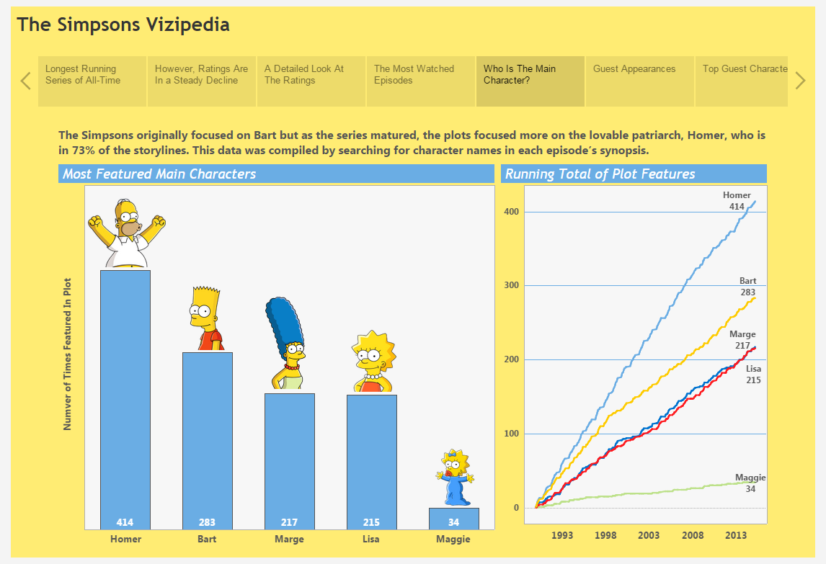
Tableau Public visualization software
Notes:
Here’s an example of a visualization made using Tableau Public. This one is pretty impressive and large, but you’d be amazed at how relatively easy it is to build something like this.

Slide 44
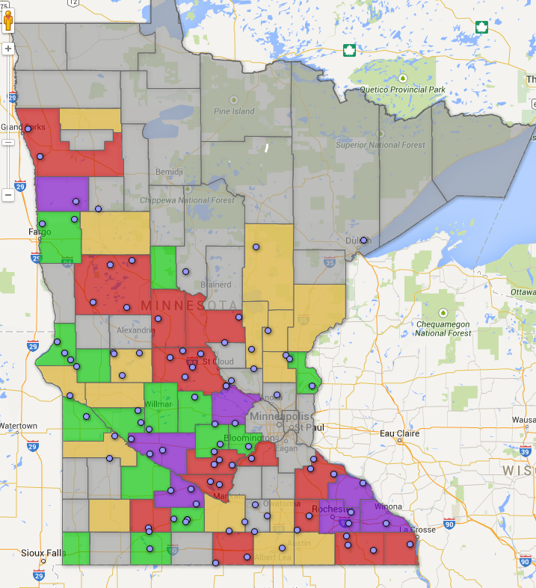
Google Fusion Tables
Notes:
Here’s a very quick and dirty example of what you can do with Google Fusion Tables. It’s probably the easiest tool out there for a reporter to quickly map their data. This is a map Jeff Meitrodt made to help him figure out where to put boots on the ground for reporting his story on farm deaths. It shows the total number of deaths in each county over the last 10 years, then dots showing deaths in the last five years. I spent a couple hours showing him how to use this software – getting the data in, mapping it and then filtering it and changing the colors so he could ask it different questions. This may or may not end up as a published map –but for now it’s a great reporting tool for him to visualize his data geographically.

Slide 45
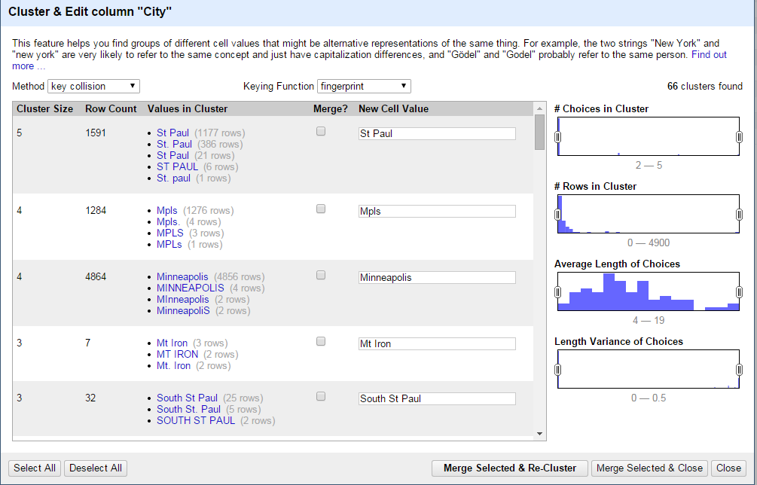
OpenRefine
Notes:
Here’s a peek at OpenRefine – a free piece of software for cleaning data. For example, this is an image of its clustering function, where it is guessing that all these variations of the spellings of St. Paul are really the same city and it allows you to easily update the data to make them all the same.

Slide 46
More advanced...
Analyze data in a database manager (such as Access, SQLite)
Scrape data from a web page (various free tools)
Analyze data using GIS software (ArcGIS or QGIS)
Notes:
A few reporters might want to get this far in their skills – this would include analyzing data with more powerful software like Microsoft Access or mapping software like ArcGIS or being able to scrape data from a web page.

Slide 47
Tapping newsroom data resources
We don’t have enough bandwidth to do everything!
MaryJo and Jeff Hargarten will work as partners with reporters in producing any data-driven content.
Contact us as early in the process as possible! The day before/of publication is unacceptable unless it’s big breaking news and crucial that we use data.
Notes:
coming into this job, my marching orders are to help all corners of the newsroom do more and better data reporting. Since it’s impossible for me to do 10 things at the same times, that means I need to work hard at teaching everybody else to fish.
But there will certainly be situations where the analysis is too complicated or the story is too important and I will need to be involved in the gathering and analysis and reporting.
The same is true of Jeff Hargarten, who is our primary means of getting interactive data on the web.
Both Jeff and I would like to be partners with you. It will not work very well if you or the reporters view us as a “service desk” that produces something and walks away. We should be involved in the process, from start to finish.
And since our resources are limited, it’s crucial that you contact us as early as possible – and also realize that we might not be able to help you. It’s all going to depend on what we have on our plates and the priority of your story against what we already have. It’s always worth asking us though.

Slide 48
Last thoughts....
Attend “Data State of Mind” and “Using numbers without fear”
More training likely later this year
Read “Data Literacy” book by David Herzog
My training materials: mjwebster.github.io/DataJ
Notes:
The other two sessions I’m doing this month will provide you even more insights. The Data state of mind will include some of the same information, but will be more focused on the reporter’s perspective and Using numbers without fear expands upon a few of the things we touched on – like putting numbers in context and making sure we’re using the right number.
There’s a new book out called “Data Literacy” that I highly recommend. It’s less than 200 pages (including the index) -- even if you just read the first two or three chapters, you would get a lot more information than what we’ve covered here.
And again, here’s the link to my training materials website. There’s a ton of tutorials, exercises, tipsheets, articles, etc.

Slide 49
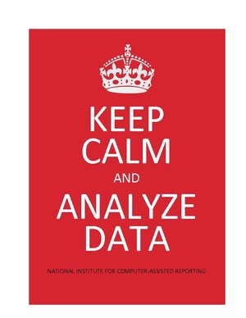
http://mjwebster.github.io/DataJ

